Slide 1
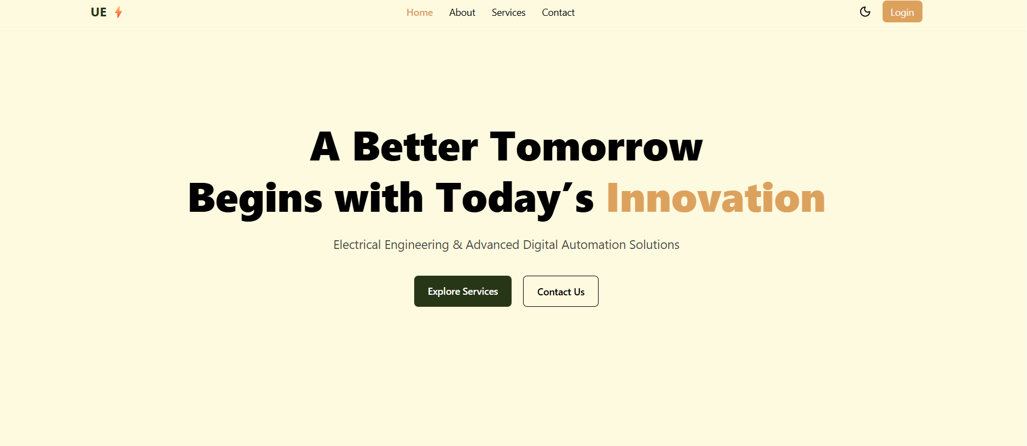



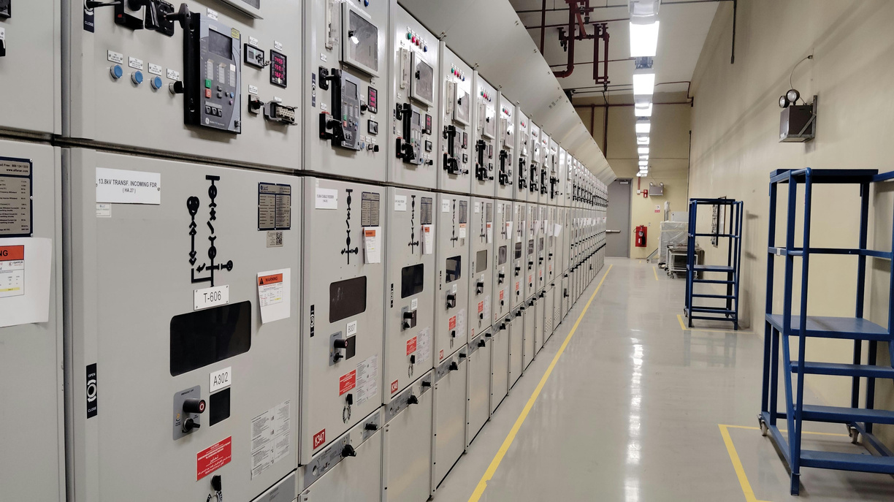

Existing
About us
“A Brighter Tomorrow Begins with Today’s Innovation”
IoT based predictive maintenance
High-Reliability DC Power tool for PLCs & HMIs
Advanced Fire Response and Safety System
Electrical panel design as IS375
New
EQUIPMENT&VESSEL MFG.
DIGITALIZATION&AI
ELECTRICAL
  Electrical panel manufacturing
  Automatic Power Factor Control panel
  Star-Delta starter for motor control panel
  Smart Industrial electrical control panel
  Maintenance of electrical panels
  Electrical panel manufacturing
  Automatic Power Factor Control panel
  Star-Delta starter for motor control panel
  Industrial electrical control panel
  Maintenance of equipment's
  AI and Digital technologies
  IoT based dashboard & data logging
  Process parameter data logging
  Energy monitoring system
  Digital Process & Operations Automation

Slide 2









WHY WE
Invotavie
Solution provider
Expertise
In house / 3P team
Supplier network
Reliable Supply of Parts
Services
Quality
Reports

Slide 3









OUR CLIENTS
Clients will confirm

Slide 4
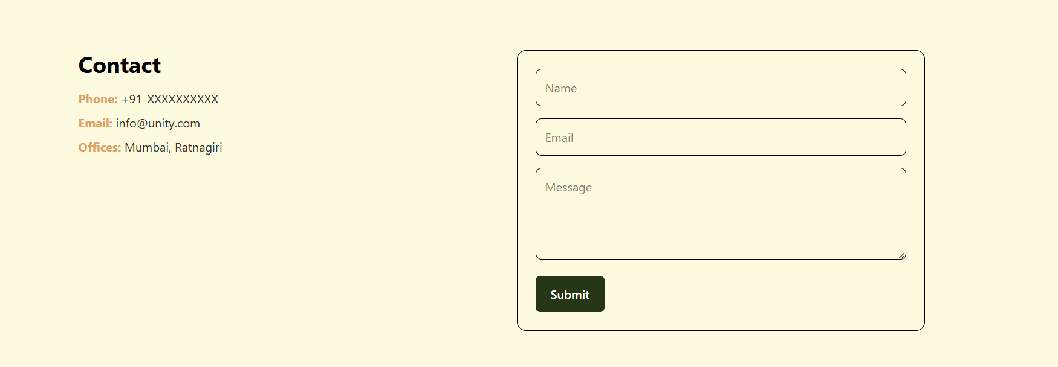
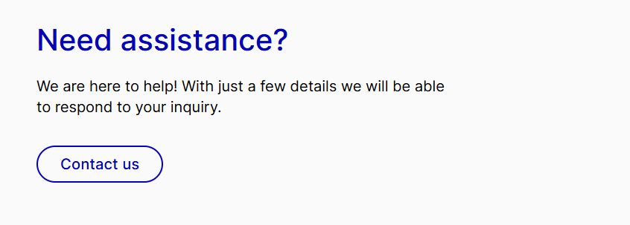
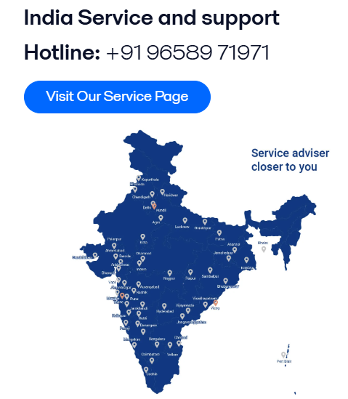



+918928691044 / +918623925697
Mum office - A/36, New seva society, Datar colony, Kurla (W), Mumbai - 400070
Regd. office - 344B, Walope, Chiplun, Ratnagiri - 415605
Unityenterprises36@gmail.com, Sales@unitytech.in, Jitesh@unitytech.in

